Slide 1
Eco System Development
Mobile Cloud with Watson Services
Leveraging cognitive computing and social media data from the mobile cloud
Notes:
IBM System for User Modeling (System U)

Slide 2
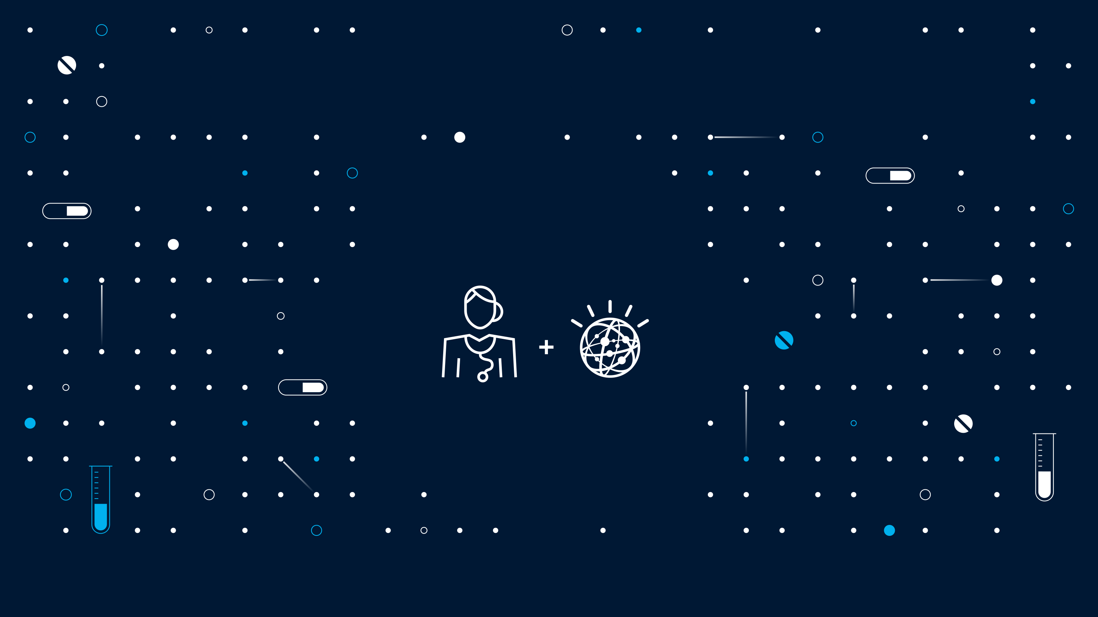

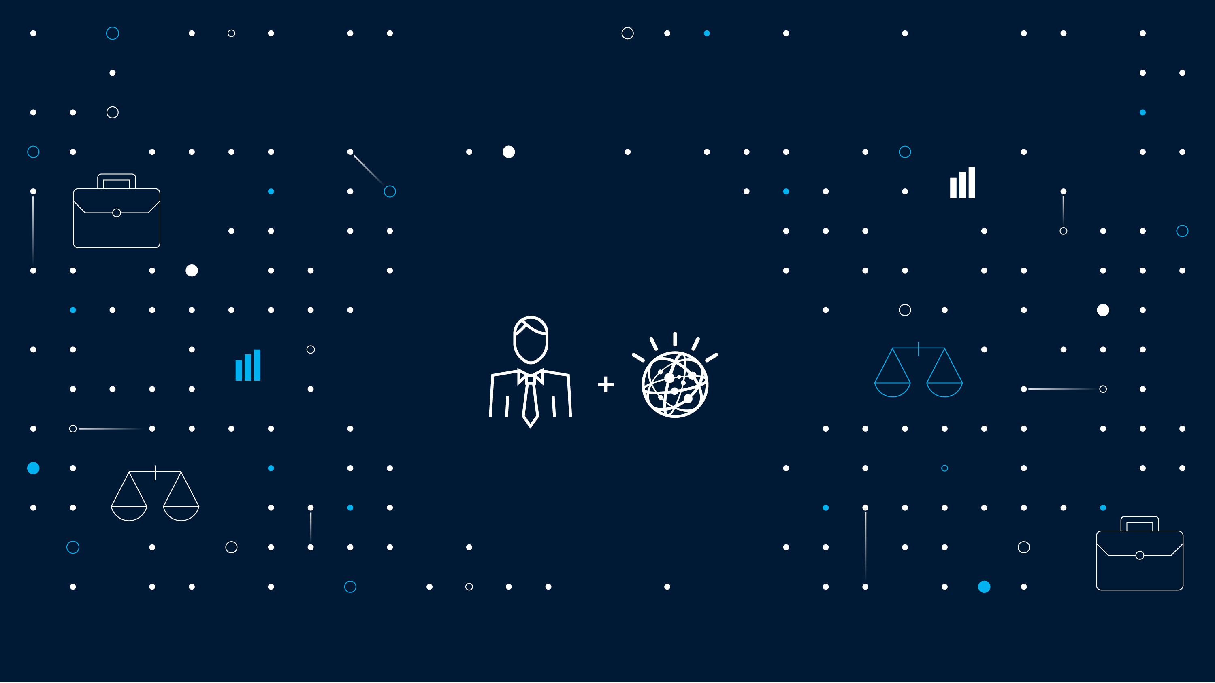






What is Watson ?
To understand Watson, we need to understand cognitive computing

Slide 3


Benefits of Watson on the Cloud Infrastructure
Enhance
the cognitive process of professionals to strengthen decision making in the moment
Reach Out
expertise by elevating the consistency and objectivity of decision making across an organization.
Accelerate development of expertise in others by capturing the expertise of top performers

Slide 4









Reusable services form the basis for all Watson cognitive solutions
Advisors
App Store
Cross Industry Editions
Target Industry Editions
Powered by Watson Offerings
Engagement
Discovery
Oncology
Wealth Mgmt.
Industry Aligned
Market Aligned
Healthcare
Call Center
Decision
Policy
Intelligence
Cooking
Travel
Research
.
.
.
.
.
.
Core Offerings
Watson Analytics
Watson Explorer
Financial Svc.
User Modeling
Developers Cloud
Specialties
Cognitive Services (APIs)
Tooling
Models
Assemble
Design
Visualize
Train
Deploy
Content
Admin
Data Services
Extract
Ingest
Curate
Annotate

Slide 5
Users access Watson services in different ways depending on their needs and goals
Watson Developer Cloud **Trial**
Watson Developer Cloud
**Sandbox**
Watson Developer Cloud
**Production**
IBM Products
**Development &
Production**
Developer free access
Beta services
Fixed content
No SLAs
Enterprise paid access to production and beta services
Use custom content
GA-level Q&A service
Dev SLAs
Enterprise training
Clients and ecosystem partners
Revenue share or monthly fee
Full service access and custom content
Prod SLAs
Select offerings include 180 day access to services
Production level when services go GA

Slide 6


Bluemix has radically expanded access to Watson services
Watson Developer Cloud
Watson Services in Bluemix
Access restricted to partners and IBM developers
Accessible by anyone with a Bluemix account
Wait until services are GA to release
Release in Beta and gather input from user community
North America
Global

Slide 7
Watson Services in Bluemix

Slide 8
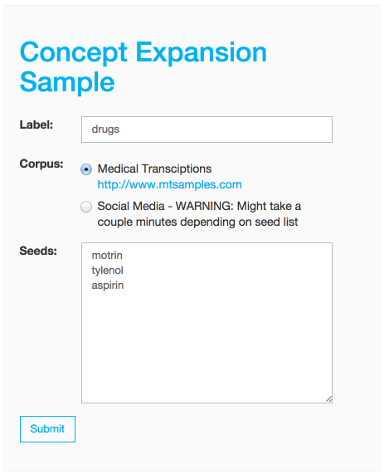
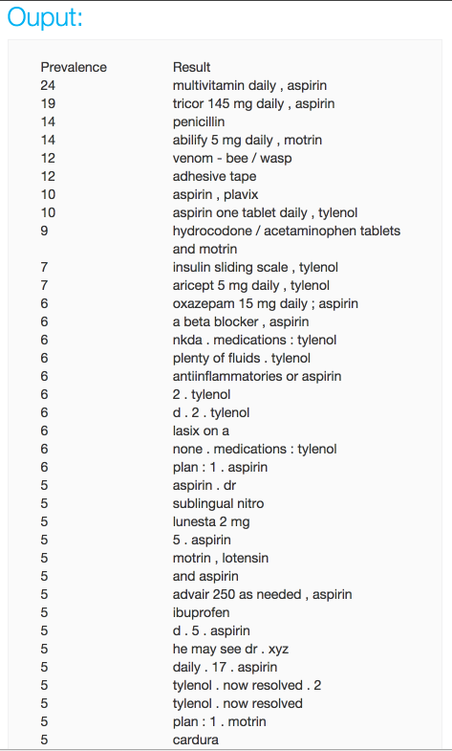
Concept Expansion
What is it?
Concept Expansion employs an interactive human-machine partnership to guide concept expansion from a suggested "seed list" with an ultra high speed pattern matching algorithm, enabling rapid development of rich entity terminologies.
Use Cases-
From a list of "SEED" terms like "apple, orange, cherry" we get all the fruit like terms mentioned in Text to "apple, orange, cherry, limes, strawberries"
Notes:
How does it work?
The Concept Expansion service analyses text and interprets its meaning based on usage in other similar contexts. For example, it could interpret "The Big Apple" as meaning "New York City". It can be used to create a dictionary of related words and concepts so that euphemisms, colloquialisms, or otherwise unclear phrases can be better understood and analyzed.
Use Cases
Can be used to expand drug typs

Slide 9
ConceptExpansion cet = new ConceptExpansion(); try { cet.setUsernameAndPassword(..,..); cet.setEndPoint("…"); } catch (Exception e1) { … } String []seeds = new String[]{"motrin","tylenol","aspirin"}; String label = "medicine"; cet.setDataset(ConceptExpansionDataset.MT_SAMPLES); Job job = cet.createJob(label, seeds); Status status = cet.getJobStatus(job); while (status == Status.AWAITING_WORK || status == Status.IN_FLIGHT) { status = cet.getJobStatus(job); try { Thread.sleep(1000); } catch (InterruptedException e) { throw new RuntimeException(e); } } if (status == Status.DONE) { List<Concept> concepts = cet.getJobResult(job); for (int i = 0; i < concepts.size(); i++) { Concept element = concepts.get(i); System.out.println(element); } } else { System.out.println("The concept coudn't be expanded"); }
Concept Expansion

Slide 10
ConceptExpansion cet = new ConceptExpansion(); try { cet.setUsernameAndPassword(..,..); cet.setEndPoint("…"); } catch (Exception e1) { … } String []seeds = new String[]{"motrin","tylenol","aspirin"}; String label = "medicine"; cet.setDataset(ConceptExpansionDataset.MT_SAMPLES); Job job = cet.createJob(label, seeds); Status status = cet.getJobStatus(job); while (status == Status.AWAITING_WORK || status == Status.IN_FLIGHT) { status = cet.getJobStatus(job); try { Thread.sleep(1000); } catch (InterruptedException e) { throw new RuntimeException(e); } } if (status == Status.DONE) { List<Concept> concepts = cet.getJobResult(job); for (int i = 0; i < concepts.size(); i++) { Concept element = concepts.get(i); System.out.println(element); } } else { System.out.println("The concept coudn't be expanded"); }
Concept Expansion

Slide 11

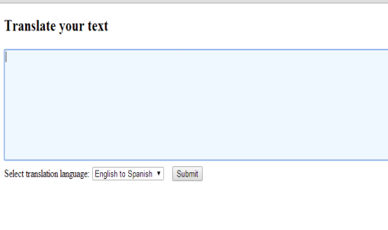
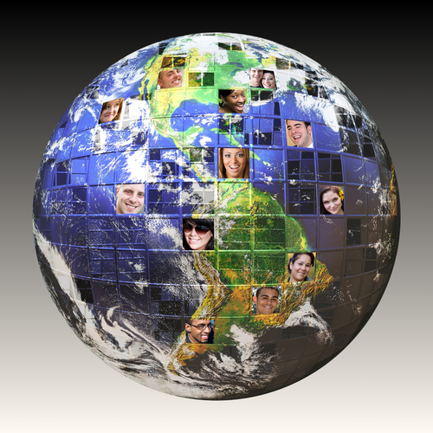
Machine Translation
What is it?
Translate text from one language to another.
How does it work?
Converts text input in one language into a destination language
Use Cases
A French speaking help desk representative is assisting a Portuguese speaking customer through a chat
Notes:
How does it work?
The Machine Translation service converts text input in one language into a destination language for the end user. Translation is available among English, Brazilian Portuguese, Spanish and French.
Use Cases-
A French speaking help desk representative is assisting a Portuguese speaking customer through a chat session and is able to interact through the translation service

Slide 12
MachineTranslation mtservice = new MachineTranslation(); try { mtservice.setUsernameAndPassword( .. , .. ); mtservice.setEndPoint("…"); } catch (Exception e1) { e1.printStackTrace(); } String response = mtservice.translate( "The IBM ECOD team is awesome", Language.ENGLISH, Language.SPANISH ); System.out.println(response);
Machine Translation

Slide 13
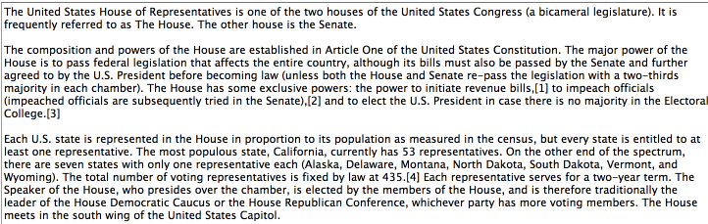
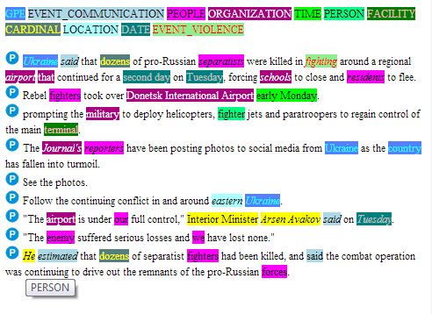
Relationship Extraction
What is it?
Intelligently finds relationships between nouns, verbs, subjects, objects, etc.
How does it work?
Parses sentences into their various components and detects relationships between the components.
Use Cases-
News article analysis to extract relevant people, organization, event type, date/time, or location
Notes:
3 mentions in yellow refer to the same person; so that you can infer that Avakov estimated the number of killed.
How does it work?
Parses sentences into their various components and detects relationships between the components. It can process new terms (like people's names in a news feed) it has never analyzed before through contextual analysis. Sentence components include parts of speech (noun, verb, adjective, conjunction, etc.) and functions (subjects, objects, predicates, etc.). The service maps the relationships between the components so that users or analytics engines can more easily understand the meaning of individual sentences and documents.
Use Cases-
The service can analyze a news article and pull out the relevant people, organization, event type, date/time, or location of actions taken. It then can relate the components such as what adjective describes what noun and what action a subject takes upon what object.

Slide 14
RelationshipExtraction ret = new RelationshipExtraction(); try { ret.setUsernameAndPassword(.. , ... ); ret.setEndPoint( .. ); } catch (Exception e1) { e1.printStackTrace(); } ret.setDataset(RelationshipExtractionDataset.ENGLISH_NEWS); String response = ret.extract( "John works in IBM. John kicked the ball." ); System.out.println(response);
Relationship Extraction

Slide 15

Question and Answer
What is it?
Direct responses to users inquiries fueled by primary document sources
How does it work?
Interprets and answers user questions based on source data and returns candidate responses with associated confidence levels and links to supporting evidence.
Use Cases-
Healthcare: What is a stroke? What is the cause of Wilson Disease?
Travel: Where is the best place to stay in Prague?
Asks a question
Understands question
Produces possible answers and evidence
Analyzes evidence
Computes confidence
Delivers response, evidence and confidence
Considers response and evidence
Notes:
Question is passed through he API
Watson decomposes the question to understand multiple interpretations of it
Generates hypothesis through multiple sources
Scores the hypothesis and evidence
Synthesis the scoring to generate a response
Delivers response Evidence
How does it work?
Interprets and answers user questions directly based on primary data sources (brochures, web pages, manuals, records, etc.) that have been selected and gathered into a body of data or ‘corpus’. The service returns candidate responses with associated confidence levels and links to supporting evidence. The current data corpora on BlueMix focuses on the Travel and Healthcare industries.
Use Cases-
Healthcare: What is a stroke? What is the cause of Wilson Disease?
Travel: Where is the best place to stay in Prague?

Slide 16
QuestionAndAnswer qat = new QuestionAndAnswer(); try { qat.setUsernameAndPassword( .. , .. ); qat.setEndPoint(".."); } catch (Exception e1) { e1.printStackTrace(); } qat.setDataset( QuestionAndAnswerDataset.HEALTHCARE ); WatsonAnswer watsonAnswers = qat.ask( "What is Migrane?" ); System.out.println(watsonAnswers);
Question and Answer

Slide 17
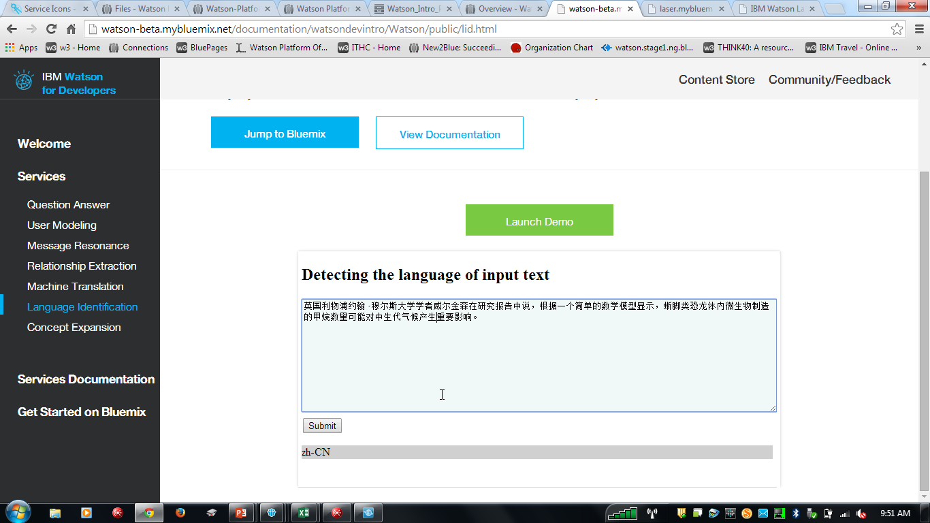
Language Identification
What is it?
Identifies the language in which text is written
How does it work?
Can be used in tandem with the Machine Translation service.
Use Cases-
A building block for Machine Translation and future tech.
Notes:
How does it work?
The Language Identification service detects the language in which text is written. This helps inform next steps such as translation, voice to text, or direct analysis. The service can be used in tandem with the Machine Translation service. Today, the service can identify 15 languages – Arabic; Chinese (Simplified); Chinese (Traditional); Cyrillic; Danish; Dutch; English; Farsi; Finnish; French; German; Greek; Hebrew; Hindi; Icelandic; Italian; Japanese; Korean; Norwegian (Bokmal); Norwegian (Nynorsk); Portuguese; Spanish; Swedish; Turkish; Urdu
Use Cases-
A building block for Machine Translation and future tech

Slide 18
LanguageIdentification lit = new LanguageIdentification(); try { lit.setUsernameAndPassword(.. , .. ); lit.setEndPoint(..); } catch (Exception e1) { e1.printStackTrace(); } IdentifiedLanguage lang = lit.identify( "Good Morning" ); System.out.println(lang);
Language Identification

Slide 19


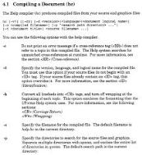
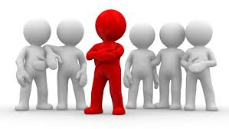
Personality Insights
What is it?
Personality insights to engage users on their own terms
How does it work?
Extracts a set of personality and social traits based on the way a person communicates.
Use Cases-
Guiding customer treatment - if a customer calls in, should my representative be friendly, outgoing, or just matter-of-fact
Notes:
How does it work?
The user Modeling service uses linguistic analytics to extract a set of personality and social traits from the way a person communicates. The service can analyze any communication the user makes available such as their text messages, tweets, posts, email, and more. Users of the service can understand, connect, and communicate with people on a more personally tailored level by analyzing personality and social traits
Use Cases-
The service can analyze text based on a customer’s twitter stream to help a travel agency decide between leading with a budget or luxury trip offer

Slide 20
PersonalityInsights pit = new PersonalityInsights(); String realstring = ""; try { pit.setUsernameAndPassword(.. , .. ); pit.setEndPoint( .. ); String str = "TXT TO BE ANALYSED,"; //typically from file/url InputStream is = new ByteArrayInputStream(str.getBytes() ); realstring = getStringFromInputStream(is); } catch (Exception e1) { e1.printStackTrace(); } ContentItem cItem = new ContentItem(); cItem.setContent(realstring); Content content = new Content(); content.addContentItem(cItem); Map<String, Object> params = new HashMap<String, Object>(); params.put("text",realstring); Profile profile = pit.getProfile(params); System.out.println(profile);
Personality Insights

Slide 21
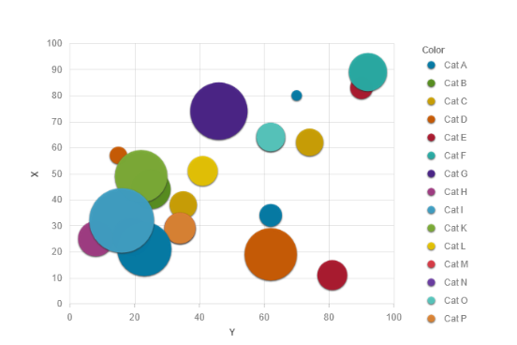
Visualization Rendering
What is it?
Graphical representations of data analysis for easier understanding
How does it work?
Graphically renders data as an interactive visualization that can be easily modified to match user needs, visual styling, and types of data being analyzed.
Use Cases-
Representation of neighborhood demographic data as showing income levels centered on geographic locations on maps
Visionary mobile prototype
Notes:
How does it work?
The service takes input data and graphically renders it as an interactive visualization which can range from a common business chart to more advanced layouts. The visualizations can be easily modified to match user needs, visual styling, and types of data being analyzed.
Use Cases-
The service could represent neighborhood demographic data as mini pie charts showing income levels centered on geographic locations on maps, or as tree maps that can switch from looking at income by age to house size or by education level.

Slide 22

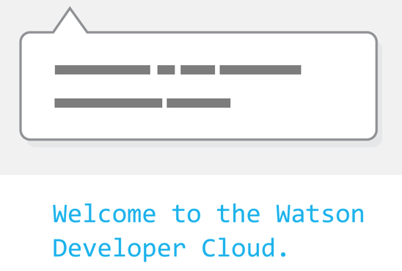
Speech to Text
What is it?
Recognition of the words that are being spoken in a live audio stream and transcribes into text
How does it work?
In addition to converting a raw audio signal into a best-guess of the words that are being spoken, intelligence about the relevant grammar / how language is used within a specific context is incorporated to generate a more accurate transcription.
Example Use Cases
Mobile apps. , Voice-control of applications / embedded devices.
Transcription of meetings and conference calls., Dictation of emails.

Slide 23

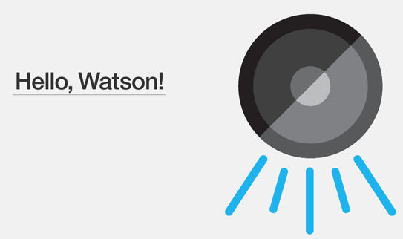
Text to Speech
What is it?
Generates an audio file that has a verbal representation of the input text – complete with appropriate cadence and intonation.
How does it work?
Converts textual input into speech, and provides the option of three voices in English or Spanish, including the American English voice used by Watson in the 2011 Jeopardy match.
Example Use Cases
Mobile apps. Read texts / emails aloud.

Slide 24
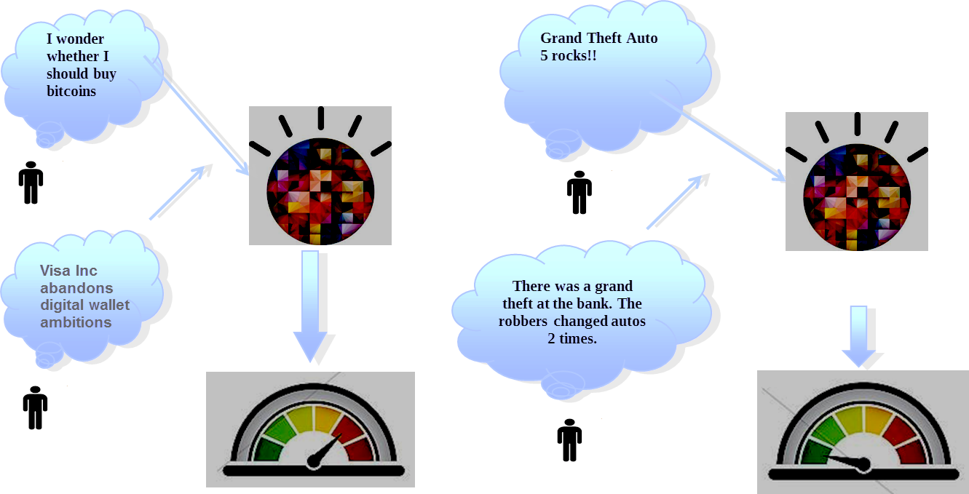
Concept Insights
What is it?
Locate relevant documents that may not directly mention your query.
How does it work?
Maps user-input words to the underlying concepts of those words based on training on English Wikipedia data. The service identifies explicit links when an input document directly mentions a concept, and implicit links when relevant concepts that are not directly mentioned.
Example Use Cases
A legal firm could utilize this service to identify cases which may be related to the case in question
Improve engagement on any external website

Slide 25
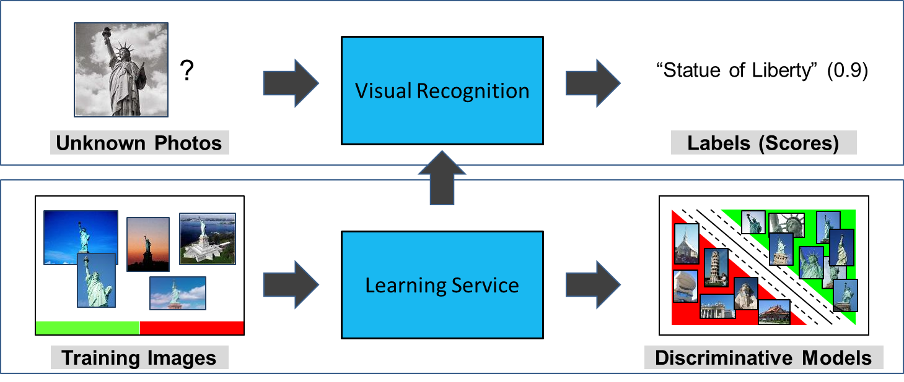
Visual Recognition
What is it?
Analyzes the visual appearance of images or video frames to understand what is happening in a scene.
How does it work?
Includes an unmatched number of preset classifier and trained labels (2,000+), a taxonomy that recognizes 150+ different sports, and can ingest 1,000+ batch images with the ability to recognize multiple labels in a picture.
Example Use Cases
Audio-visual indexing and search of media archive
Automatic "Smart Album" generation
Marketing data analysis from social media

Slide 26
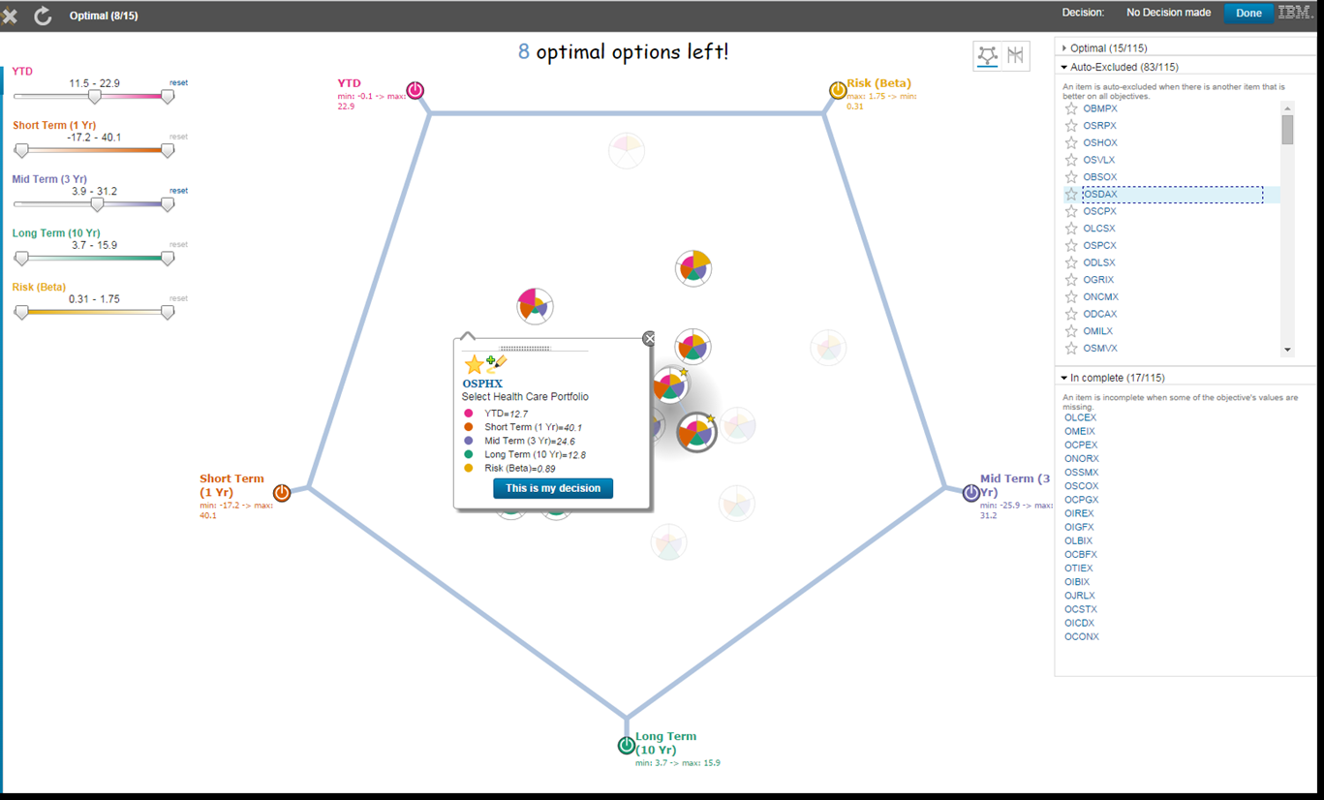
Tradeoff Analytics
What is it?
Helps make better choices under multiple conflicting goals with smart visualizations and analytical recommendations.
How does it work?
Uses Pareto filtering techniques in order to surface only the optimal alternatives across multiple criteria. It then uses various analytical and visual approaches to help the decision maker analyze the tradeoffs.
Use Cases
Helps to determine product mix or to compare competitive products

Slide 27
How to use the Personality Insights API
Create an instance of the Personality Insights service
Bind the service to your application
- For ecosystem users: take the url and credentials information from the Bluemix UI and configure your application to access Personality Insights from outside of Bluemix (e.g. Public Cloud, Private Cloud, etc)
- For Bluemix customers: create an application in Bluemix and bind the service instance you created in #1 to it
Build your application
Links to Bluemix documentation, Personality Insights docs & samples:
Information about connecting to Bluemix and integrating the Personality Insights service into Bluemix applications
Sample source code in Node.js, Java, and Ruby for using Personality Insights service in applications
Notes:
This chart dives deeper into the top part of the picture on the previous slide (from the datapower up) and gives a clear indication of the two deployment paths and how they are different/same.
The slide also points to the BlueMix documentation and the User Modeling docs and samples

Slide 28
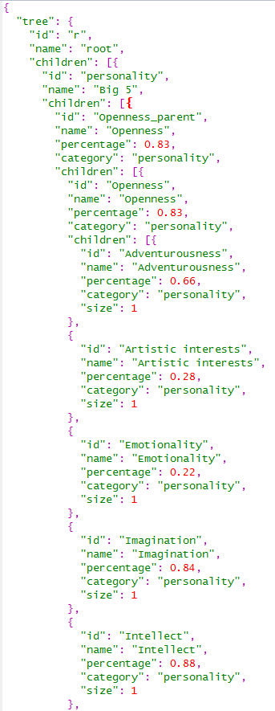
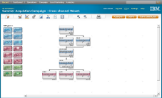
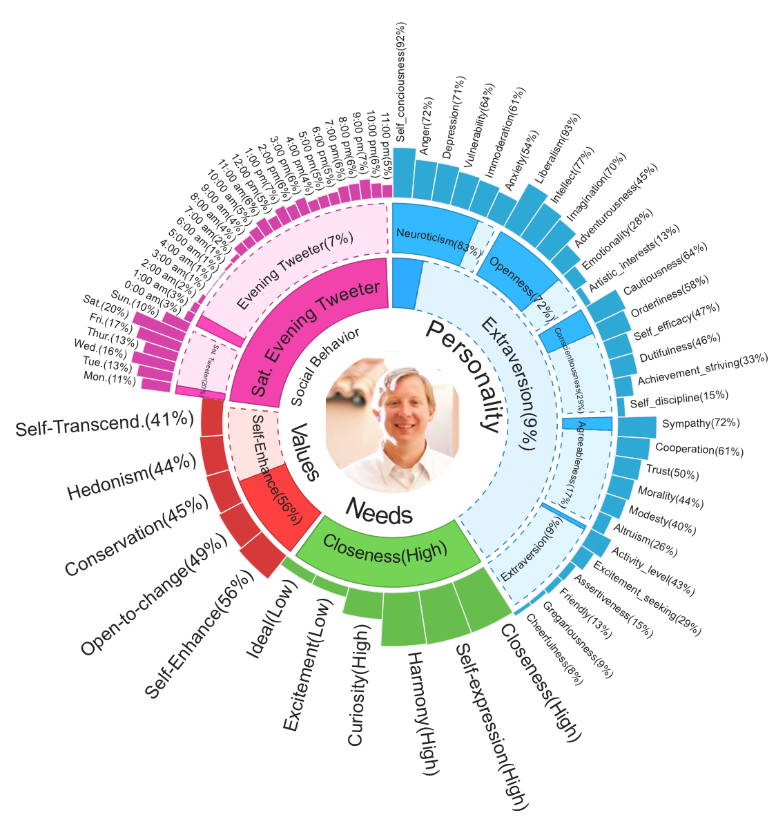

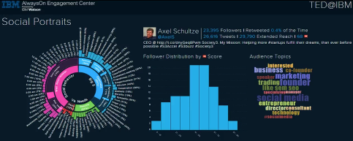
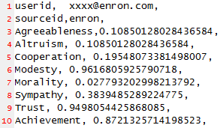
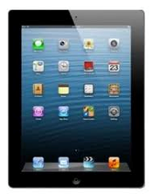
Personality Insights API Architecture
Input Parameters
Portrait API Implementation
(runs in Java EE 6.0 Web Profile containers)
JSON output
Applications
SPSS, Unica, Cognos, Kenexa
Text data
Data Model (JSON)
Social media, emails, etc.
Analysis Platform
Interactive Visualizations
Watson Ecosystem
Linguistic Algorithms
Generic Text Ingest
Big-5 Personality
Basic Human Values
Formats: JSON, Text, HTML
Fundamental Needs
Json output
Hybrid
Mobile App
Mobile Web
Notes:
Integrate User Modeling analytics with your applications using the following two REST API calls*:
Portrait API (POST method) - accepts a list of content items with their metadata and analyzes them returning the results in JSON format. It produces a tree of cognitive and social characteristics including Big 5 personality, Values, and Needs.
Visualize API (POST method) - accepts the output generated by the Portrait API above and produces a visualization of that portrait.
Start explaining this chart left to right:
User Modeling APIs can analyze data from social sites, personal communications, and enterprise data sources
User Modeling Portrait API analyze the data applying innovative approach based on years of experience gain in multiple disciplines.
The out put of User Modeling is flexible: It can be explored with the Visualize API, utilize it on mobile devices, or by using the provided APIs it can be imported into other enterprises’ systems and products such as IBM Unica or other Visual analytical tools.
How to use the User Modeling APIs
Create an instance of the User Modeling service
Bind the service to your application
- For ecosystem users: take the url and credentials information from the Bluemix UI and configure your application to access User Modeling from outside of Bluemix (e.g. Public Cloud, Private Cloud, etc)
- For Bluemix customers: create an application in Bluemix and bind the service instance you created in #1 to it
Build your application
Links to Bluemix documentation, User Modeling docs & samples:
Information about connecting to Bluemix and integrating the User Modeling service into Bluemix applications
Sample source code in Node.js, Java, and Ruby for using User Modeling service in applications

Slide 29

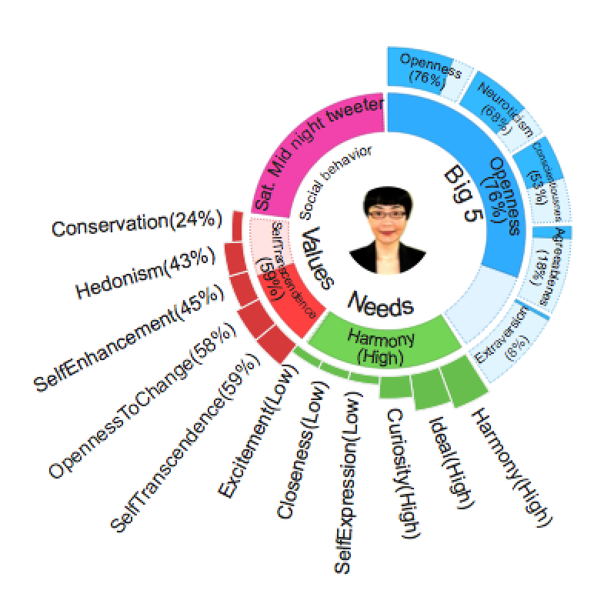
Personality Insights in a Nutshell
Engagement
Recommendation
Linguistic
Analytics
Personality
Portrait
Big 5
Values
Needs
Social Media
Attitude
EmotionStyle

Slide 30
Watson has been trained to be an Analyst
Performs complex linguistic analytics
"I love food, .., with … together we … in… very…happy."
Word category: Inclusive
Agreeableness
Analyzes hundreds of millions of documents in seconds, from social media and other enterprise sources
Hundreds of millions of people leave media "footprints" within social media text
Evaluate groups (segmentation) or individuals
Also adapts text to portray a specific personality
Notes:
Watson analyzes documents published in social media or other sources using complex linguistic analytic methods. The results of the analysis form the customer portrait.
Portraits can be evaluated in groups, or as individuals, to provide insight for varying applications.

Slide 31
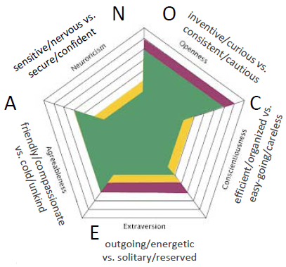
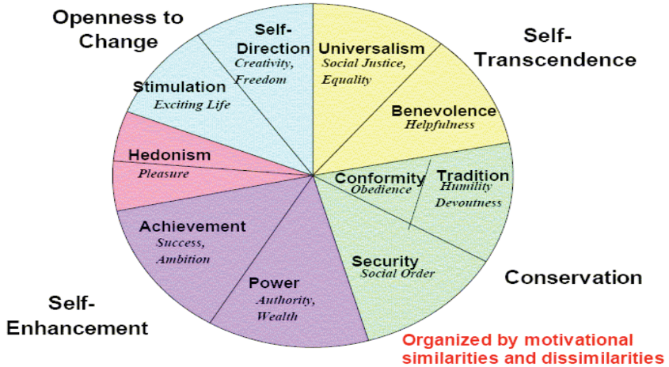
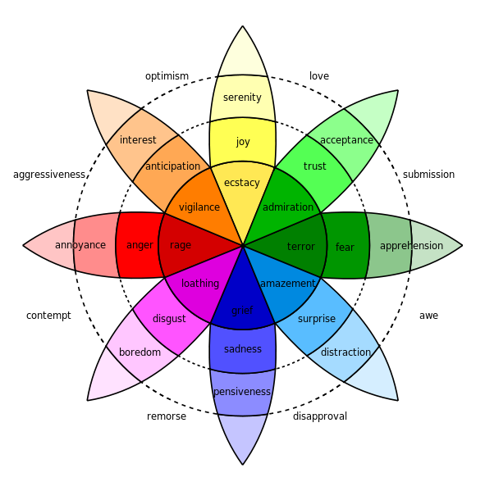
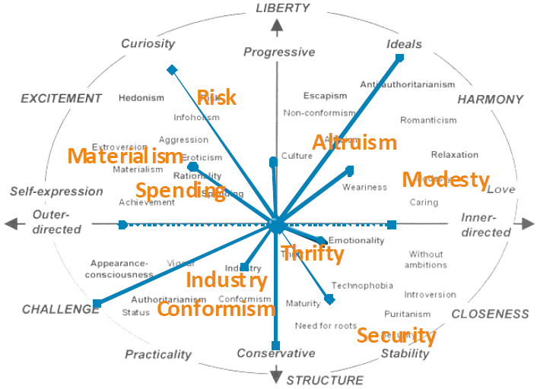
Discovering with Personality Insights
Discovering Characteristics
Basic Human Values
BIG 5
OCEAN
Emotional Style Modeling
Fundamental Human Needs
[Plutchik ‘11]
Notes:
Our people analytics technologies take one's linguistic footprints, and analyze them to automatically derive a person's personality, cognitive, and social preferences. Based on the derived preferences, our people engagement technologies will then recommend hyper-personalized products and services to individuals.
Our current set of people analytics technologies use an individual's linguistic footprints (e.g., tweets and Connections blog or forum posts) to automatically derive one's cognitive and social preferences. In particular, we have developed the following analytic appliances:
Big 5 Personality Model: Personality characteristics that differentiate one individual from another. Big 5 (OCEAN) personality is the most studied and well-known personality model.
Basic human values: one's belief and motivators. One could hold numerous values but with varying degrees of importance. Our current model includes 6 dimensions of human values based on Schwartz's work in Psychology.
Fundamental human needs: one's fundamental needs. Our current model is based on Maslow's hierarchy of needs as well as Ford's work on Marketing and consumer-related needs modeling.
Emotional style: how one's emotional or affect states look like and change. This helps us answer questions such as what is the emotional outlook of an individual and how resilient a person is emotionally.
Big 5 Personality Model:
Personal preferences reflecting individual differences
Consistent and enduring
Changes over decades
Link to many aspects of behavior
Brand/product choices
Problem, emotion coping
Relationship selection
Occupational proficiency
Team performance
. . .
Basic Human Values [Schwartz 2006]
by established questionnaires, the Human Values have been demonstrated to encompass various other value propositions and to affect various actions of interest
Values motivate people and guide their actions
Values transcend specific actions and situations
Emotional Style Modeling
Modeling Emotions
PAD (Pleasure, Arousal, Dominance) scales
Pleasure = how pleasant an emotion may be
Arousal = intensity of the emotion
Dominance = controlling and dominant nature of the emotion
Plutchik's Wheel of Emotions
8 primary emotions arranged as opposing pairs
Advanced emotions are composed of 2 neighboring emotions
Modeling Approach
Machine learned from a variety of different data sets, including:
ANEW, LIWC, EARL, LiveJournal, …
Fundamental Needs
Fundamental needs are universal [Aaker 1995, Maslow 1943]
Often change with life events
Link to many aspects in one’s life
Brand/product choices
Occupational choices
Motivation …
Method:
Developed custom survey to acquire ground truth (need data)
Machine-learned model using linguistic features collected in survey data

Slide 32
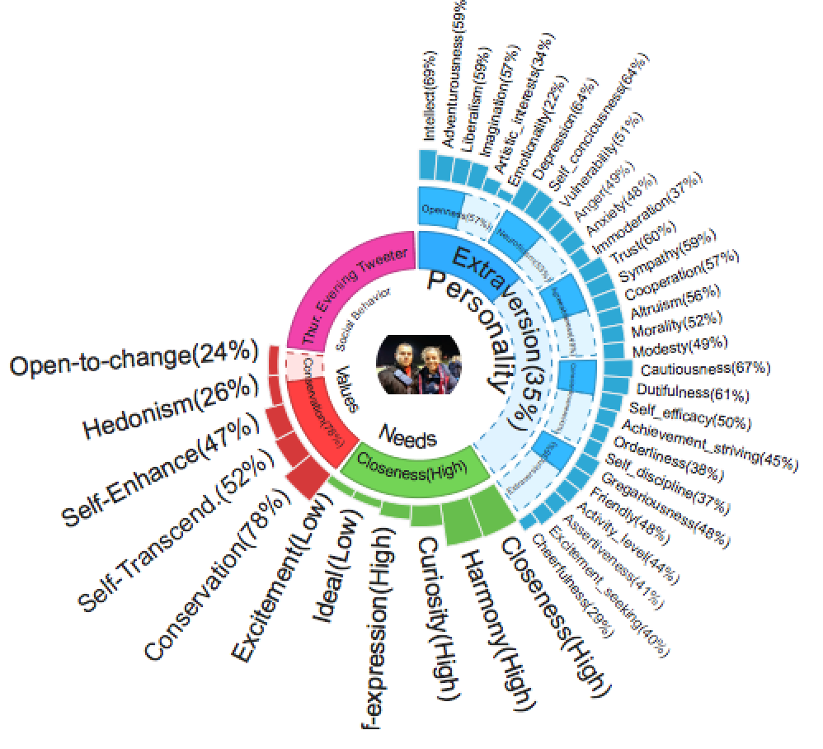

Example of a Customer Portrait
API output in JSON
Starting Point: 52 traits & facets
Notes:
Personal preferences are psychological, affective, and cognitive characteristics that uniquely identify one individual from another;
Personality preferences, inferred from social media, are correlated with corresponding psych-metric scores for over 80% test population
Big 5, human basic values, and fundamental needs
Personality preferences, inferred from social media, can predict real-world responses in a live setting
Discovering Personal Preferences
Basic preferences
• Personality
• Human basic values
– What people believe and their motivational constructs
• Fundamental human needs
• Emotional style
– Patterns of affective states and changes
• Cognitive style
– How people think, perceive, and remember information
Composite preferences
– Trust
– Resilience
Detailed explanation of each of the preferences: http://pilab.psy.utexas.edu/publications/Yarkoni_JRP_2010b.pdf

Slide 33
Benefits of Watson Cognitive Services to End User
Understands me
Engages me
Learns and improves over time
Helps me discover
Establishes trust
Has endless capacity for insight
Operates in a timely fashion on big volumes of data (noisy social media)
Provides to you only the most relevant information
33

